Slide 1
Data Visualization
Data Visualization is a process of taking raw data and transforming it into graphical or pictorial representations such as charts, graphs, diagrams, which explain the data and allow you to gain insights from it.
Data visualization is a quick and easy way to convey concepts to the end-users.
Data visualization brings data to life, making you the master storyteller of the insights hidden within your numbers.
Bar and column charts are some of the most widely used visualization charts in Power BI.

Slide 2
Importance of Data Visualization
Clarifies which element influences customer behavior.
The better you visualize your points, the better you can leverage the information to the end-users.
The right data visualization helps you to boost the impact of your data.
Clarifies which element influences certain behavior.

Slide 3
Creating Charts
An efficient chart requires the shortest period of perception in order to obtain a correct and complete answer to a given question.
Power BI Charts give you a multi-perspective view of a certain data set. These charts represent different findings and insights from a given data set. The charts can give you reports with a single visualization or pages full of visualizations.
Power BI Charts aren’t static but highly interactive & highly customizable with the ability to update constantly, as the underlying data changes. You can add and remove data, change chart types, and apply filters in your model to discover insights and look for answers.

Slide 4
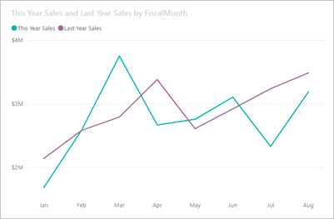
Line Charts
The line chart shows the change of values over time.
Line charts are mainly used for time series data.

Slide 5
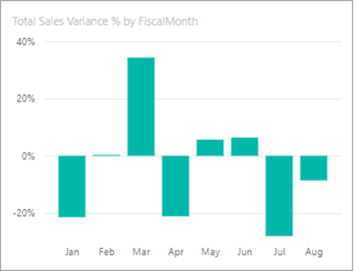
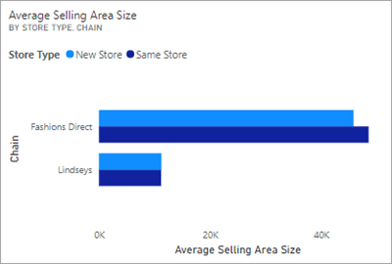
Bar And Column Charts
Bar charts are horizontal charts that represents or compares categorical data.
Column charts are used to compare the same data by forming some clusters and comparison between those clusters.

Slide 6
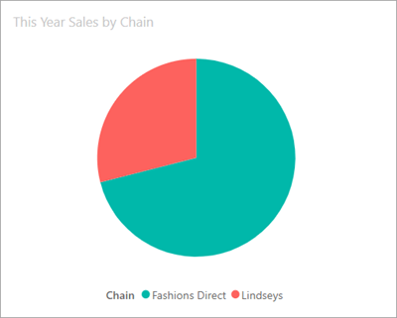
Pie Charts
Pie charts are used to show the composition of the whole data in parts.
Each component of a pie chart is represented in percentages and the sum of all the parts should equal 100%.

Slide 7
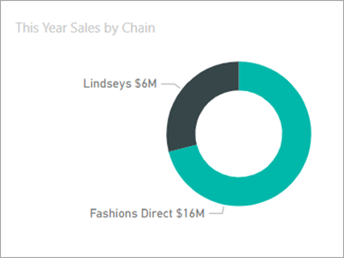
Doughnut Charts
Doughnut charts are similar to pie charts.
They can be used to show the composition of the whole data in proportions. Doughnut charts prove to be most useful when required to exhibit the various proportions that make up the final value.

Slide 8
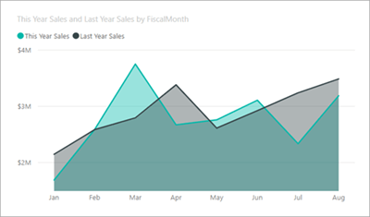
Area Charts
This is a basic chart to show a comparison of more than two quantities. It is based on line chart and used to display quantitative data and the magnitude of change over time. In this chart, the area between the axis and line is filled with different patterns, colors, and textures.

Slide 9
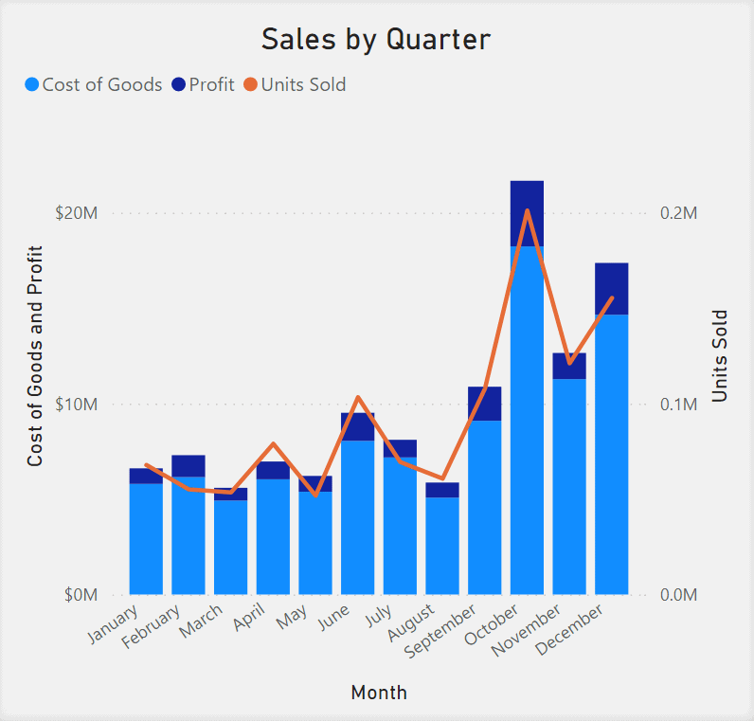
Combo Charts
It’s a combination of column chart and line chart. Combo charts are used to combine measure values that are normally hard to combine because they belong to different scales.

Slide 10
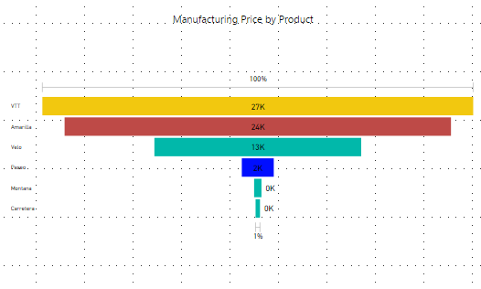
Funnel Charts
Funnel charts are used to show the process that leads to a conversion. They are a good option when the data is sequential and when the first stage has a larger number of “items” than the final stage.
It helps you visualize a process that has stages or levels.

Slide 11
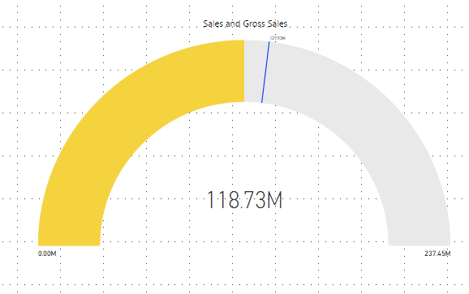
Gauge Charts
Gauge charts are used to show the progress towards a particular goal.
The Gauge visual displays the current value against a goal or Key Performance Indicator (KPI).

Slide 12
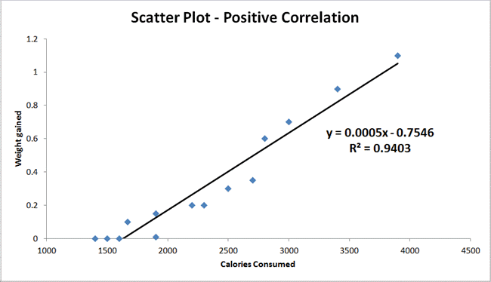
Scatter Chart
Scatter plots are used to observe relationships between variables.
We also have "Line of Best Fit" (also called a "Trend Line") on our scatter plot.

Slide 13
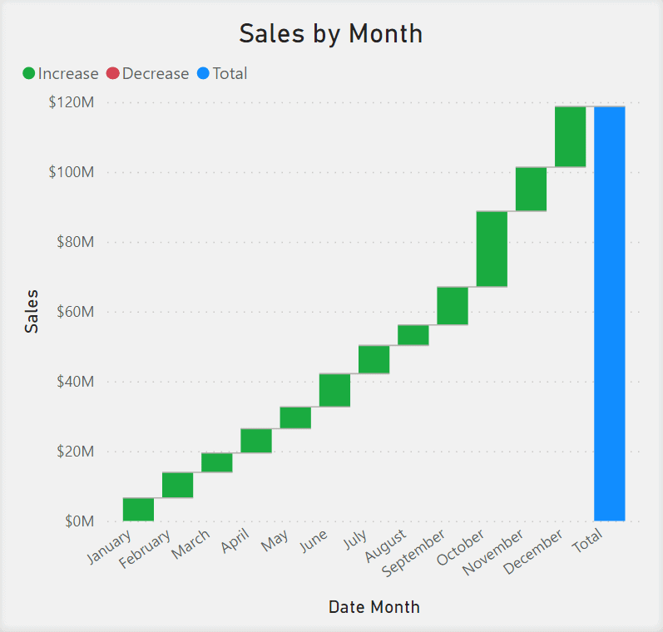
Waterfall Chart
The Waterfall Chart illustrates how an initial value is affected by positive and negative changes.
The chart shows a running total as values are added or subtracted.

Slide 14
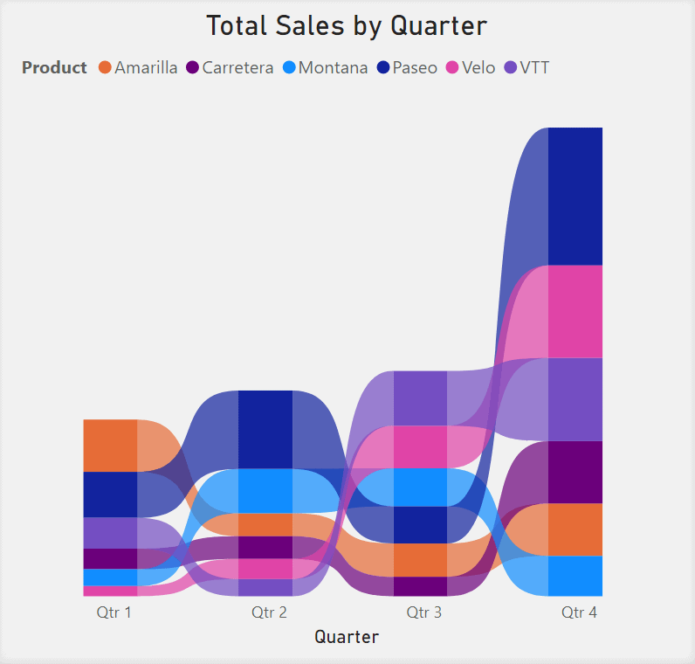
Ribbon Chart
The Ribbon Chart displays ranked data categories illustrated through ribbons, where the highest rank is always displayed on the top ribbon for each period.

